Slide 1
Journal Entries in Polish Heritage Classes
Polish Heritage Speakers: Linguistic Profile,
Pedagogical Challenges
Anna Zofia Gąsienica Byrcyn, Ph.D.
Saint Xavier University
2017 AATSEEL Conference, San Francisco

Slide 2
What is a Journal?
A journal as a literary genre is defined as a fictive narrative work written for publication, constructed according to a calendar sequence.
In the case of a travel diary, it is written according to the stages of a journey, having artistic and aesthetic value.

Slide 3
The diary or diary-like forms have been important media of expression.
Montaigne’s Essais, Rousseau’s Confessions, Pascal’s Pensées, or Sartre’s diary-novel La nausée illustrate the presence of journals and memoirs in the world of literature.

Slide 4
Well known Polish literary diaries are:
Miron Białoszewski Pamiętnik z powstania warszawskiego
Maria Dąbrowska Dzienniki (written from 1914-1965)
Widold Gombrowicz Dzienniki (1953 – 1969)
Gustaw Herling-Grudziński Dziennik pisany nocą
Zofia Nałkowska Dzienniki (6 volumes from 1899-1954)
Sławomir Mrożek Dziennik (1962-1969, 1970-1979, 1980-1989)
Jan Chryzostom Pasek Pamiętniki
Zofia Stryjeńska Chleb prawie że powszedni. Pamiętnik
Stefan Żeromski Dzienniki (1953-1956)

Slide 5
The Common Futures of Some Diaries:
journals are written with a public reader in mind
there is a blurring of the boundary between fiction and non- fiction
they have extroverted orientation, self-encapsulation, clarifying personal identity
diaries are first person narratives
journals are usually consciously constructed works of art

Slide 6
Journal in Polish Heritage Classes
In the Intermediate Polish classes students write journal entries linked to the topics in their textbook to practice vocabulary, idiomatic expressions, and grammar (otherwise they don’t know what to write about, their life is uneventful, after classes most of them go to work – that is what they claim).
Students write their journals with a public reader in mind – their classmates.
Sometimes there is a concealing of the boundary between fiction and non-fiction, students make take on a fictitious persona, if they feel uncomfortable and they do not want to disclose their personal information and opinions.
Otherwise they concentrate on I – the student and most of their journal entries are written in the first person narratives.

Slide 7
Their diaries, journals, memoirs, itineraries, and scrapbooks can be used as enrichment activities in the process of learning the art of writing with a focus on Polish art, music, literature, history, and traditions.
Depending on the skill level and interests of the class, these topics may include:
their brief biography
childhood pursuits
a family gathering
their likes and dislikes

Slide 8
leisure/sport activities
plans for the future
a typical weekend
a typical day
winter break/summer vacation
the worst day/or the happiest day
an adventure
a review of a preferred movie
a critique of a chosen book

Slide 9
a description of a favorite place in Poland
a presentation of a famous Polish person
a cultural activity they attended in the Polish community
a Polish cultural event on campus
a concert experience
a visit at a museum or an art gallery
a role of technology in a student’s life
a dream or a fantasy tale

Slide 10
The most important aspects of writing a journal are:
expressing clearly thoughts and ideas
applying learned grammatical structures and rules in writing
retaining appropriate vocabulary, idiomatic expressions in journal entries
using synonyms and new learned vocabulary

Slide 11
Brief Biography
Mam dwadzieścia dwa lata i jestem studentem. Studiuję kryminologię i biznes. Pracuję na pół etatu w Jimmy John’s. Urodziłem się w Chicago i cały czas tutaj mieszkam. Moi rodzice urodzili się w Polsce. Do USA przylecieli dwadzieścia lat temu. Mam starszego brata, który studiuje w Northeastern. Bardzo lubię uprawiać sport. Gram w koszykówkę i futbol amerykański. Często chodzę na siłownie, dlatego jestem dobrze wysportowany.

Slide 12
Mam 21 lat. Urodzilem się w Chicago. Teraz mieszkam w Bridgeport. Chodzilem się do polskiego szkola Emilia Plater na kilka lat. Studiuję chemia, ale cem być aptekarzem. Mojem ulubionym sportem jest pilkę noznem. Lubię jezdic na rowerze.

Slide 13
Winter Break
Podczas moich wakacji zimowych, nie miałam dużo czasu na odpoczynek. Ja pracowałam w biurze jako sekretarka od poniedziałku do piątku, od godziny ósmej rano do piątej wieczorem. Trudno było wstawać tak wcześniej podczas wakacji zimowych, ale dużo pieniędzy zarobiłam. Wtedy kiedy nie pracowałam w biurze, to pracowałam w aptece CVS. A kiedy nie pracowałam to przygotowywałam się na święta razem z moją rodziną. Kiedy okres świąteczny się skończył, miałam więcej czasu na odpoczynek. W tym czasie czytałam interesujące książki i spałam. Czasami nawet chodziłam do klubu razem z moimi koleżankami. Kiedy się zbliżał koniec wakacji, mój wujek i kuzyn przylecieli z Polski. Ostatnie dni wakacji spędziłam razem z moją rodziną.
Notes:
The student is using the same expressions.
Kiedy=gdy
wakacje zimowe = ferie

Slide 14
Moje wakacje czuło się krótkie. Te cztery tygodnie szybko przeleciały. Cale wakacje pracowałam w Boys and Girls Club, taki program dla dzieczi po szkole. Pierwszy tydzień po pracy zrelaksowałam w domu. Leżałam na kanapie i paczyłam telewizor. Drugi tydżien pojechałam na narty z kolegami na weekend. Miałam dużo zabawy. Reszte czasu szybko preleciało. Nie dojrze wakacje szybko preleciałi chociaż miałam czas widzieć moją rodzinę i znajomych. Może następnym razem czas spowolni się.

Slide 15
My Favorite Place in Poland
Moim ulubionym miejscem w Polsce jest Stargard Szczeciński. Mój tata pochodzi z tego miasta i moi dziadkowie tam mieszkają. Kiedy lecimy do Polski, zawsze mieszkamy u dziadków. Nie pozwiedzałem dużo miast w Polsce, ale lubię jechać do Stargardu, ponieważ mogę zobaczyć inną kulturę niż w Ameryce. Kiedy jesteśmy w Stargardzie, jeździmy nad morze i spędzamy cały dzień na plaży. Czasem dziadzia zabiera tatę i mnie na polowanie do lasu. Lubię jachać na polowanie, bo przeważnie jest cicho i można posiedziecz sobie i zrelaksować się. Jest fajnie siedzieć na ambonie przy pełni księżyca, ponieważ można wszystko widzieć. Kiedy jedziemy do Stargardu jesienią, idziemy na grzybobranie. Stargard Szczecinski jest bardzo ładnym miastem w Polsce, ponieważ ma wiele natury, ale też można zwiedzać zabytki.

Slide 16
Plans for the Future
Ja mam wiele planów na moją przyszłość. Chciałbym zostać lekarzem, ale wiem, że będę musiał bardzo ciężko pracować. Poza tym, chciałbym zwiedzać świat. Może pojadę do Australii albo do Ameryki Południowej, ponieważ jeszcze tam nigdy nie byłem. W przyszłości chciałbym też pojechać na ryby nad ocean i złowić rekina. Moim celem jest ukończenie studiów. Kiedy skończę szkołę, to chciałbym wyjechać tam, gdzie jest ciepły klimat, bo nie lubię zimy. Chcę też utrzymać kontakt z kolegami. Wiem, że to nie będzie takie łatwe, bo pewnie będziemy mieszkać daleko od siebie. Jeszcze nie wiem napewno co będę robił w przyszłości, zależy mi na osięgnięciu szczęśliwego życia.

Slide 17
W przyszłości chcę dalej iść do szkoly i mięć jak najwięcej edukacji. Nie wiem dokładnie kim bym chciała być. Ale wiem, ze napewno będę w szkole przez dłuższy czas. Chciała bym może zostać prawnikem. Chodziasz wiem o tym, że to jest najgorszy czas na prawnika, bo ich jest tak dużo. Po tych studjach chcę iść na magistra. Bym chciała magistra zrobić w komunikacji. Chyba będę iść na inny uniwersytet, bo bym chiciala pracowac. Bym na pewno chciała mieć ładny domek i szczęśliwą rodzine. Cheć mieć dwujke dzieci i małego pieska.

Slide 18
It is better to ask students to type, otherwise their handwriting is sometimes unreadable:

Slide 20
Why journal entries are especially important in teaching heritage speakers?
Most heritage speakers improve their spelling and grammar skills in written assignments.
Moreover, they practice new vocabulary, idiomatic expressions.
They work on their writing style.
They learn to use synonyms.

Slide 21
What are the most common grammar errors that heritage speakers make in journal entries?
Verbs endings in the present tense, because heritage speakers do not write diacritic marks instead of studiuję they write studiuje which is actually a third person singular ending and not the first person singular.
Heritage speakers often avoid diacritics in their writing or some students place them in a wrong place, for instance they write such letter combinations which do not exist in Polish at all: –ći, -ńi, -źi, śi.

Slide 22
Past tense of –eć and –ąć verbs.
Past tense of verbs of motion: iść, pójść, przyjść, wejść, wyjść, etc.
Determinate and indeterminate verbs, when to use iść and when chodzić; jechać and jeździć.
Past tense because of gender endings.
Many students write verbs in the third person plural after such quantifiers as: dużo, wiele, mało instead of writing the verb in the the third person singular,

Slide 23
Genitive singular ending of masculine inanimate nouns.
Accusative of the demonstrative pronoun ta which is tę, but students write tą.
Nominative plural of virile nouns because of consonant softening.

Slide 24
Locative singular of nouns because of consonant softening.
Dative endings: instead of the plural –om, students write -ą.
Relative pronoun który in sentences which require a knowledge of the rules on the use of cases.
Sometimes they write the conjunction że instead of an appropriate form of który,
And in general, heritage speakers do not know the rules on the use of cases, most of the time they count on their intuition.

Slide 25
What are the most common lexical errors that heritage speakers make in journal entries? How to eliminate them?
Some heritage speakers do not know idiomatic expressions.
Some students translate literally from the English into the Polish, for example they translate literally: I am having a good time as Mam dobry czas instead of Dobrze się bawię.
They use the noun szkoła all the time when they describe their colleg/university experiences.
Heritage students use the same expressions, they don’t use synonyms because they have limited vocabulary.

Slide 26
One way to eliminate these errors is to teach students many idioms in the advanced classes and encourage them to read a lot in Polish, and to watch Polish film, Polish news, and have many acquaintances who speak Polish, so they could listen to them and to practice Polish.
However, the best way for the heritage speakers to learn modern Polish would be to send them to Poland for a Study Abroad Program.
Many of them go to Poland on their summer vacation, there they stay with their friends and family, usually making a progress in speaking, but not in writing.

Slide 27
What types of written assignments are the most problematic for them and what are those that they are usually strong at?
Assignments which use grammatical terminology are difficult for them because students are not familiar with the basic grammatical concepts even in English.
Thus, if they are to write a paragraph using perfective verbs in the past, most of them have no idea what perfective verbs are in Polish.
There are some cases when students cannot tell the tense.
But if they are asked to write a paragraph about their activities performed and completed yesterday, most of them will write utilizing perfective verbs.

Slide 28
Are there any topics they seem to be much more eager to write about? Are there certain subjects they find difficult to write about?
Students love to write fiction. They enjoy writing fairy tales and fantastic tales not linked directly to them.
Students who plan to enter a medical field prefer to write on the topics linked to the health issues, diet, and healthy life style.
In general, heritage speakers enjoy writing about topics they are really interested in ( sport, preferred activities, etc.)
Some students also write well about personal experience some avoid such topics.

Slide 29
Should we enforce standard Polish in written assignments or, in certain cases, we should let the usage of dialects or "Chicago Polish"?
Standard Polish should be enforced, no dialects or Chicago Polish.
Students are enrolled in Polish classes to improve their Polish and to learn standard, modern Polish, so to sound sharp and smart outside of the classroom when they find a job and use Polish or when they travel to Poland.

Slide 30
Keeping a journal is one of the best written activities. Students write one entry per week in the JOURNAL The topics of their entries are connected to the lessons in their textbooks, that way, the students practice and use new, learned vocabulary.
WIKI JOURNAL is an excellent writing activity.
All the students are able to see what everyone is working on.
However, some students are uncomfortable to show their writing on WIKI. They prefer to keep a traditional notebook/journal.

Slide 31
What sort of writing strategies should we try to enforce to make heritage students more efficient in writing?
Students should begin to write early in Polish 101 starting with 5 sentences, later writing a longer paragraph of 10 – 12 sentences , then a half a page, to one page and more.
Keeping a journal in Polish is a good way to practice writing on a regular basis.
It is important that the students learn to write in paragraphs starting in Polish 101 with such topics as: presentation of various people (friends, family members, famous Poles) depicting a room, a pet, a city, writing a brief invitation, an advertisement, letters, and e-mails.

Slide 32
What would you recommend to a heritage speaker that you like to improve his or hers writing?
A good writing involves a great amount of reading and knowledge of grammar, synonyms, syntactic structures, discourse skills.
Good writers plan more, use an outline in the prewritten stage, reread frequently what they write, revise more often, and make changes in the content.
Many heritage students do not rewrite, do not check up expressions in their dictionary or use reference grammar books.
They write their assignments in one sitting without planning, reflecting, or rewriting.

Slide 33
How to grade written homework? Should we pay more attention to the effort and idea (content), to the form (whether it is properly composed and adequate in terms of style) or to the grammar correctness?
Longer compositions should be graded on the basis of their originality.
But it is always crucial to stress the importance of the correct grammar, use of appropriate vocabulary especially in the first and second year Polish.
And to avoid vulgar expressions and slang in students’ compositions.

Slide 34
Polish Heritage Language Classes are usually multilevel.
Each Beginning, Intermediate or Advance class can be divided into 3 groups: High, Mid, Low.
Therefore, it is a challenge to teach a mixed level class.
Students benefit from writing journal entries, weekly or biweekly to improve their writing, to practice vocabulary and grammar in a given lesson.

Slide 35
Study Abroad –Trip to Poland – with a Journal
In 2005 I planned, co-organized, and co-hosted a Polish Culture/Business course at Saint Xavier University that included a trip to Poland.
Students visited major cultural monuments in Warsaw, Gdańsk, Gdynia, Kraków, Częstochowa, Oświęcim, Wadowice, Wieliczka and Zakopane travelling by plane (from Kraków to Gdańsk) and by a tour bus.
They attended a couple of lectures on Polish literature, culture and economy at the Jagiellonian University.

Slide 36
Students enrolled in Polish Culture kept a travel diary in which they wrote about their Polish experience.
They posted their own photographs, postcards, tickets to museums, concerts, bus, and plane tickets, map of Poland or a map of a particular city, pressed flowers and leaves.
Their Journal/Diary/Scrapbook was the most valued and appreciated souvenir from Poland.

Slide 37
Our tour began in Krakow, Poland’s former royal capital, the city where legends, history and modernity intertwine.
We visited the Main Market Square which is the oldest part of the Old Town, established at the crossroads of trade routes in 1257, Sukiennice or the Cloth Hall built in the XIVth century, the Gothic Collegium Maius – central building of Jagiellonian University established in 1364, the Basilica of the Assumption of the Holy Virgin Mary, known as Mariacki Church with a magnificent Gothic wooden altar and the Wawel Castle, the seat of kings situated on a limestone hill on the Vistula River.

Slide 38
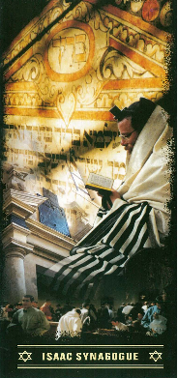
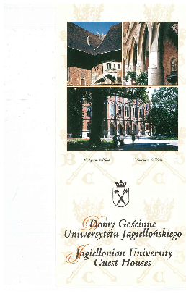

Slide 39
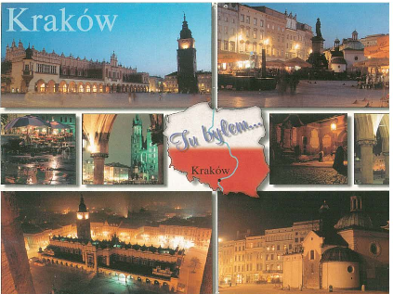

Slide 40
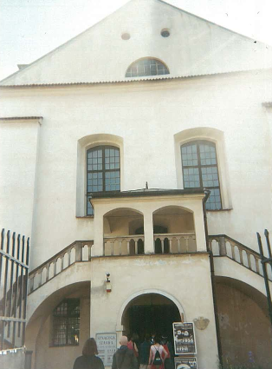
The trip also included Krakow’s Kazimierz district where Jews began settling in the late XVth century to see Europe’s oldest preserved synagogue.

Slide 41
Jewish Cemetery in Kazimierz Krakowski

Slide 42
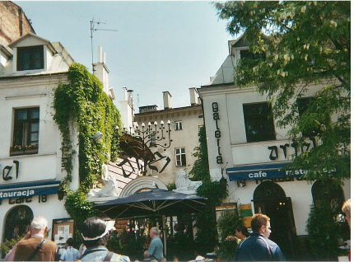
At Ariel Restaurant students listened to Klezmer music.

Slide 43
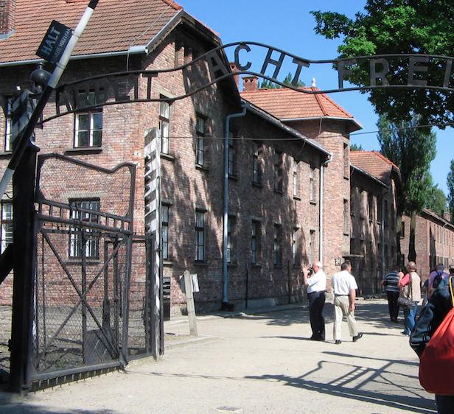
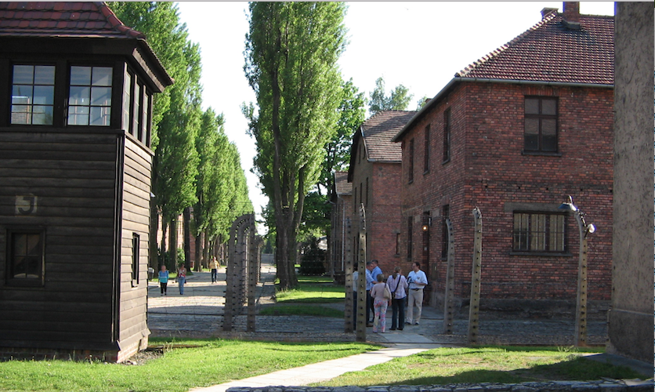
One day was given to a tour of Częstochowa and Oświęcim - Auschwitz site of the infamous German concentration camp.

Slide 44
Częstochowa

Slide 46
On the weekend we we went to Wadowice, the birthplace of the Pole John Paul II and then, we traveled to Zakopane situated in the stunning Tatra Mountains where we hiked and then took a raft down the Dunajec river in the Pieniny Mountains.

Slide 47
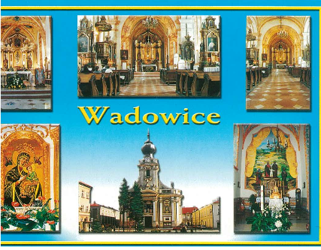

Slide 50
On the Dunajec River in the Pieniny Mountains

Slide 51
Then, we flew to the Baltic Coast and we visited Gdańsk, a Hanseatic port more than 1,000 years old, the cradle of the Solidarity social movement and have a business visit in Gdynia, a modern flourishing Polish port.

Slide 53
The Monument to the Fallen Shipyard Workers 1970 /the Three Crosses Monument commemorates the victims of December 1970

Slide 54
Swans by the Baltic Sea

Slide 55
We ended our trip in Warsaw, the capital of Poland where tradition intermingles with modernity.
While in Warsaw we had business visits.

Slide 58
We toured the Castle Square in the Old Town, reconstructed after World War II, the New Town, the Royal Łazienki Park, a magnificent complex founded by the last king of Poland Stanisław August Poniatowski.
We took the Royal Route to Wilanów where king Jan III Sobieski established his residence in the baroque palace.

Slide 60
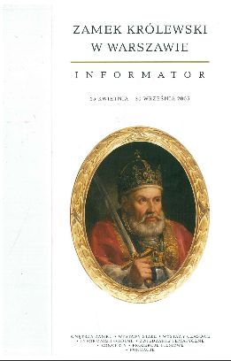
Brochures from the visit at the Royal Castle in Warsaw and a piano recital at the Łazienki Palace.

Slide 61
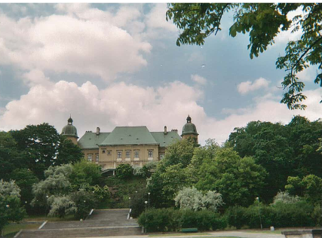
The Ujazdowski Castle in Warsaw

Slide 62
We also visited Żelazowa Wola, the birthplace of Fryderyk Chopin.

Slide 63
After 12 days some students returned to the USA, while others stayed visiting their relatives in different parts of Poland.
During this trip students were exposed to the most significant cultural monuments of Poland and Polish language.
They created their journals/scrapbooks from their direct impressions and active involvement with the Polish culture while traveling around Poland.

Slide 64
References:
Iwona Janowska. Planowanie lekcji języka obcego. Kraków: Universitas, 2010.
Ewa Lipińska & Anna Seretny. Między językiem ojczystym a obcym. Nauczanie i uczenie się języka odziedziczonego w chicagowskiej diasporze polonijnej. Kraków: Księgarnia Akademicka, 2012.
Ewa Lipińska, Anna Seretny, ed. Z zagadnień dydaktyki języka polskiego jako obcego. Kraków: Universitas, 2006.
Władysław T. Miodunka, ed. Kultura w nauczaniu języka polskiego jako obcego. Kraków: Universitas, 2004.
Anna Seretny, Ewa Lipińska. ABC metodyki nauczania języka polskiego jako obcego. Kraków: Universitas, 2005.

Slide 65
Textbooks Dealing with the Art of Writing in Polish:
Piotr Garncarek. Czas na czasownik. Kraków: Universitas, 2011.
Anna Pięcińska. Co raz wejdzie do głowy – już z niej nie wyleci, czyli frazeologia prosta i przyjemna. Kraków: Universitas, 2006.
Andrzej Ruszer. Oswoić tekst. Podręcznik kompozycji i redakcji tekstów użytkowych. Kraków: Universitas, 2011.
Marek Wójcikiewicz. Piszę, więc jestem. Podręcznik kompozycji i redakcji tekstów. Kraków: UJ, 1993.

