Slide 1
Fairy Tales in Polish Advanced Heritage
Composition Classes
Strategies for Building a Successful Polish Language Program
Professional Development Workshop for Instructors of Polish
University of Chicago, May 2, 2015
Anna Gąsienica Byrcyn, Ph.D.
Loyola University
agasienicabyrcyn@luc.edu

Slide 2
Writing is a crucial component in language classes.
The task of writing addresses diverse students’ needs to develop effective skills in the area of:
critical thinking
literacy
composition capacities

Slide 3
Working with fairy tales offers:
a resourceful, motivating, and original way of learning complex syntactic structures
more precise and varied vocabulary use
effective handling of topics, which are
beyond personal experience

Slide 4
Students learn to write in the past tense & in a chronological manner a narrative that contains:
a plot
characters
a setting
conflicts/problems resolutions
the moral

Slide 5
As the first-rate models to follow, offer only exceptional masterpieces from the genre of the Polish fairy tales.
Good writing involves lots of high-quality reading in the target language.

Slide 6
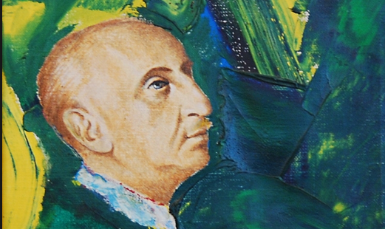
Bolesław Leśmian (1877-1937)

Slide 7
Bolesław Leśmian, a Polish-Jewish poet, writer, essayist, translator, literary critic, & philosopher born in Warsaw, wrote unique fairy tales entitled:
Przygody Sindbada Żeglarza (The Adventures of Sindbad the Sailor)
Klechdy sezamowe (Old Tales of Sesame)
Klechdy polskie (Polish Old Tales)

Slide 8
Bolesław Leśmian’s The Adventures have parallels with many classic literary works, for example, Homer’s Odyssey, Virgil’s Aeneid, and Ovid’s Metamorphoses.
The frame story, or framing device, the “story within a story” technique used by Leśmian in his tales can be traced back to Persian and Indian storytelling traditions of ancient Sanskrit literature, as well as, One Thousand and One Nights, a collection of Middle Eastern and South Asian stories and folk tales collected in Arabic during the Islamic Golden Age.

Slide 9
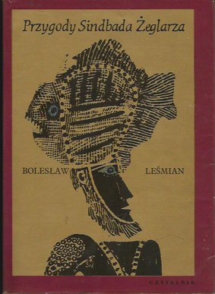

Slide 10
Marian Pankowski, in his book, Leśmian, czyli bunt poety przeciw granicom, suggests that the Oriental setting of The Adventures of Sindbad the Sailor has its roots in the lavish Polish Baroque, the Sarmatian culture which adopted luxurious decorations of homes, exquisite attire, and arms ornamented with gems from the East, Turkey in particular. After King Jan Sobieski’s victory of Vienna in 1683 the Oriental character intensified in Polish culture.
As an example of Leśmian’s Baroque aesthetics, Pankowski cites the passage describing in great splendor the Valley of the Diamonds in Sindbad’s second voyage.

Slide 11
Tymoteusz Karpowicz, an outstanding Polish poet, in his book Poezja niemożliwa sees Leśmian’s Adventures as essentially philosophical tales.
Karpowicz considered Leśmian to be a philosopher rather than an aesthete.
One of Karpowicz’s favorite stories to illustrate his point is Sindbad’s fourth adventure. Sindbad and sailors are shipwrecked on the island settled by the cannibal dwarfs. The dwarfs are very hospitable. They offer a magical potion that leads to loss of memory.

Slide 12
The sailors lose their memory and that leads them to an absurd death of self-devouring.
Hence, memory, according to Karpowicz, saves us from the world that devours us.

Slide 13
Read Leśmian’s Adventures of Sindbad the Sailor on several levels as:
an excellent fairy tale in poetic prose
a mesmerizing philosophical tale
a captivating book of adventure & fantasy
the author’s dream of travels and wealth
a metaphor of one’s life as a journey

Slide 14


Slide 15
While reading:
look for Leśmian’s brilliant humor, grotesque, & wit, especially evident in the presentation of the imaginative protagonists and the comic & unexpected situations they find themselves in
pay attention to the theme on the creative process of writing presented in the grotesque figure of Uncle Tarabuk
focus on the lively ambiance of the tales & their colorful Oriental motifs
concentrate on the exciting plot with its unusual & enthralling action

Slide 16
Leśmian’s Adventures serves as a great model to write a fairy tale on:
journey/travel (Sindbad’s 7 voyages)
writing process (uncle Tarabuk, flaming Seramina)
body parts (cannibal dwarfs)
color (green horses, blue city, black Armina)
music (Urgela)
dance (green horses, willow, stream, fish)
eating & drinking (Stella, cannibal dwarfs, Najdroższa)

Slide 17
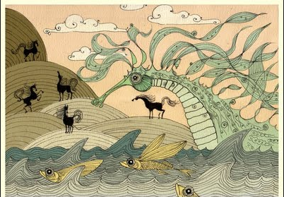
Dancing Green Seahorse

Slide 18
Students write their own fairy tale after reading Leśmian’s Adventures or a selection from his work on one of the themes.
Their imagination gets wild producing fantastic tales.

Slide 19
Writing is a process involving multiple revisions.

Slide 20
An effective composition is original.
It has a captivating introduction appealing to readers’ imagination, well constructed arguments & a good conclusion.

Slide 21
Paragraphs are well balanced & organized & linked to each other.
The style of a good composition is expressive, clear, & unique creating an appropriate mood.

Slide 22
Before submitting compositions students:
write a plan
revise, make changes in the content
reread frequently what they write
check grammar & spelling
use synonyms
follow a guideline on the Art of Writing

Slide 23
Guidelines on the Art of Writing
Plan a schedule for your writing to organize your time effectively for your revisions.
Define your target audience.
Come up with an interesting topic.
Research your topic by reading, taking notes, paraphrasing, summarizing, etc.
Write an outline.
Write a draft of the main body.

Slide 24
Write a captivating introduction.
Organize your composition into well structured paragraphs linked meaningfully to each other.
Come up with interesting ideas, facts, examples, your observations, impressions.
Check for a case, number & gender agreement, correct tense & verb endings, appropriate conjunctions, prepositions + case etc.

Slide 25
Check the spelling of words.
Use synonyms to avoid the same expressions.
Write all the necessary diacritics.
Write clear & effective sentences.
Reread your paper frequently.
Revise your paper, make changes.
Make sure that your text is original, informative, valuable, beneficial, etc.

Slide 26
Give references at the end of your paper, if needed.
Proof read your entire essay before submitting it.
Make sure that the overall presentation in your paper is clear.
Write & print your composition on spotless, neat & white sheets of paper because your work represents you.

Slide 27
The result is rewarding for students & teachers.
Anastazja i magiczna książka is one of the fairy tales written by Paulina, a Polish Heritage Student in the Polish Composition & Conversation class, the third year Polish course.

Slide 28


Slide 29
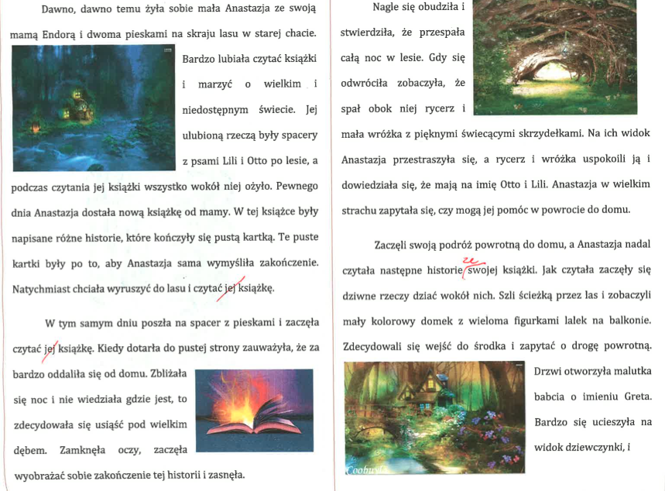

Slide 30
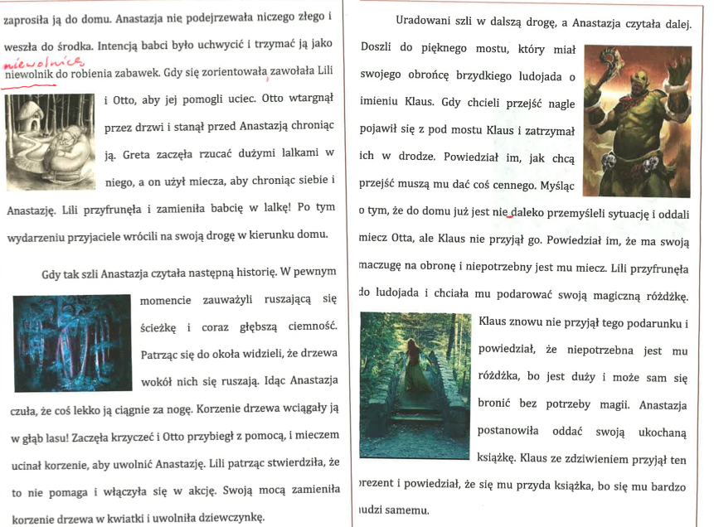

Slide 31
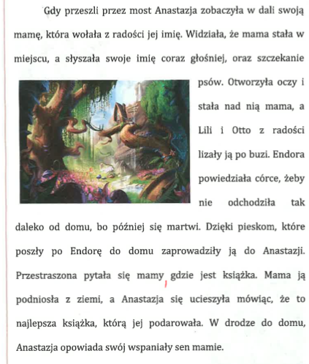

Slide 32
Textbooks on the Art of Writing:
Anna Pięcińska. Co raz wejdzie do głowy – już z niej nie wyleci, czyli frazeologia prosta i przyjemna. Kraków: Universitas, 2006.
Andrzej Ruszer. Oswoić tekst. Podręcznik kompozycji i redakcji tekstów użytkowych. Kraków: Universitas, 2011.
Marek Wójcikiewicz. Piszę, więc jestem. Podręcznik kompozycji i redakcji tekstów. Kraków: UJ, 1993.

Slide 33
Sources on Bolesław Leśmian’s Fairy Tales:
Grodzki, Bogusław. Leśmianowska baśń nowoczesna. O „ Przygodach Sindbada Żeglarza” Bolesława Leśmiana. Lublin: Wydawnictwo Uniwersytetu Marii Curie-Skłodowskiej, 2012.
Karpowicz, Tymoteusz. Poezja niemożliwa. Modele Leśmianowskiej wyobraźni. Wrocław: Ossolineum, 1975.
Leśmian, Bolesław, Przygody Sindbada Żeglarza. Warszaw: Czytelnik, 1913.
Pankowski, Marian. Leśmian, czyli bunt poety przeciw granicom. Lublin: Wydawnictwo Uniwersytetu Marii Curie-Skłodowskiej, 1999.

Slide 34
Wawryk, Joanna. Wokół Leśmianowskich baśni dla dzieci. Wrocław: Oficyna Wydawnicza ATUT Wrocławskie Wydawnictwo Oświatowe, 2013.
Zimand, Roman. „Preliminaria do klechd Leśmiana.” In: Studia o Leśmianie. Ed. Michał Głowiński and Janusz Sławiński. Warszawa: Państwowy Instytut Wydawniczy, 1971.

Slide 35
Other Recommended Sources:
Bielawski, Józef. Klasyczna literatura arabska. Zarys. Warszawa: Wydawnictwo Akademickie Dialog, 1995.
Czabanowska-Wróbel, Anna. Baśń w literaturze Młodej Polski. Kraków: Universitas, 1996.
Kubiak, Władysław, ed. Księga tysiąca i jednej nocy. Wybór. Warszawa: Państwowy Instytut Wydawniczy, 1982.

